Slide 1
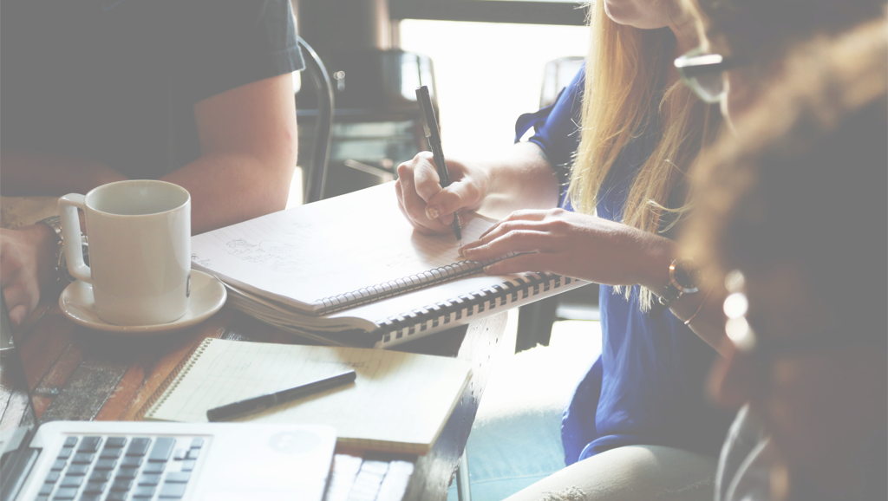
BetterMeet
Low-fi Prototyping & Pilot Usability Testing
October 22nd, 2015
CS 147 – Behavioral Change
Theodora C, Derin D, Tommy F, Liza G
Notes:
Evolving BetterMeet brand.
Selected interface.
Prototype structure and tasks.
Field work. Participant experiments.
Results
Looking ahead

Slide 2
VALUE PROPOSITION
BetterMeet:
Purposeful Meetings
Notes:
Have you ever been in a meeting and wondered why you were there? Have you gathered people only to realize no one knows what the meeting’s about? Let’s face it: everyone hates meetings. BetterMeet is the solution to ineffective meetings: create an agenda, only invite people who are absolutely necessary, and ensure everyone’s on the same page.

Slide 3
MISSION STATEMENT
AT BETTERMEET,
OUR MISSION IS TO CHANGE THE WAY PEOPLE THINK ABOUT MEETINGS
AND MAKE MEETINGS MORE PURPOSEFUL.
Notes:
At BetterMeet, our mission is to change the way people think about meetings and make meetings more purposeful.

Slide 4
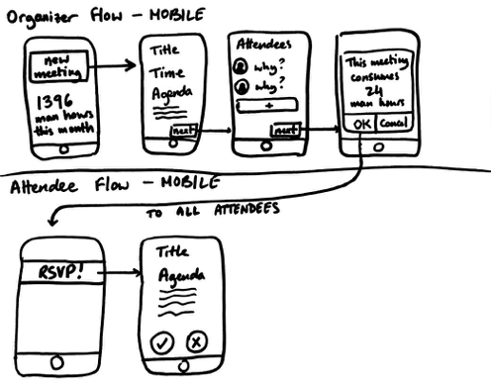
SELECTED INTERFACE
Notes:
Why did we choose it? Reasoning? What can you do with it?
Watch vs. Web vs. Mobile
More importantly, however, we realized that due to the touch-only interface of mobile, interaction had to be simple and effective at the same time. We wanted the agenda and attendee invite reasons to be concise. Since no one wants to spend hours typing on a phone, the mobile interface enables us to enforce this behavior.
Place roadblocks. First, we decided from earlier user feedback that the reasons for inviting each person should be the organizer’s responsibility. This way, the attendees aren’t annoyed, and it is more difficult for the organizer to schedule the meeting in the first place
“man hours” idea from the second sketch storyboard and decided to implement that in two places in our final selection. running tally over the course of the last month. extra pop-up man hours adding to tally.
By forcing the organizer to second-guess their choices and see the impact scheduling the meeting has on others’ productivity, we hope that they will be more likely to invite less people.

Slide 5
PROTOTYPE STRUCTURE
Notes:
Go over structure and tasks at the same time

Slide 6
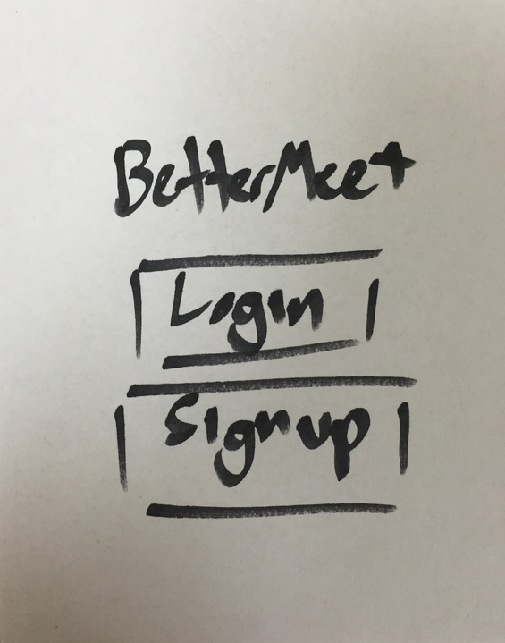
Notes:
Login page

Slide 7
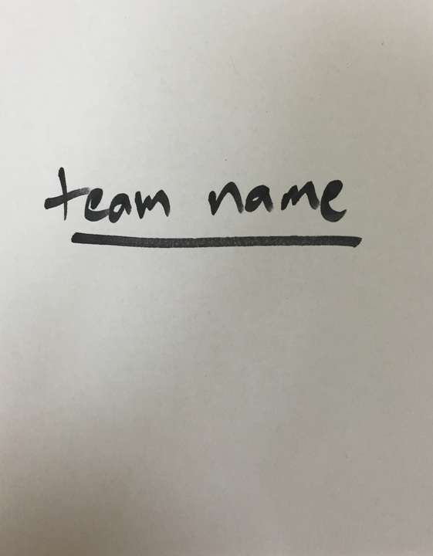
Notes:
Set team name (a la Slack)

Slide 8
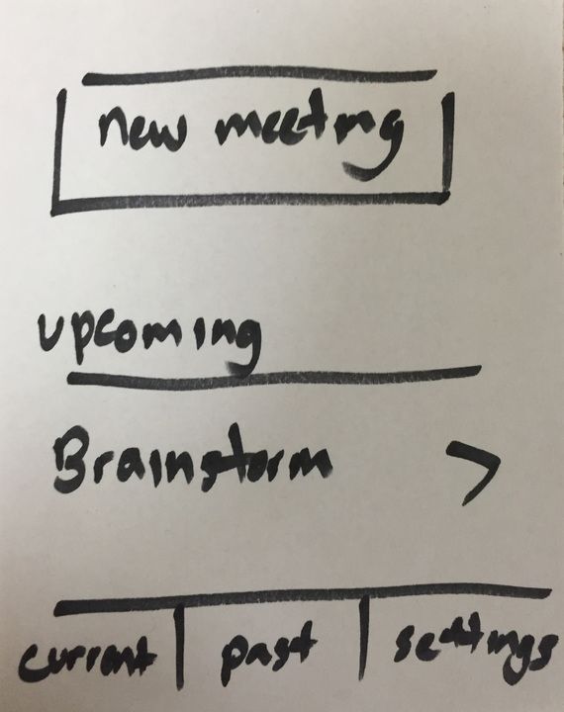
Notes:
Create new meeting

Slide 9
TASK 1: SET THE MEETING AGENDA

Slide 10
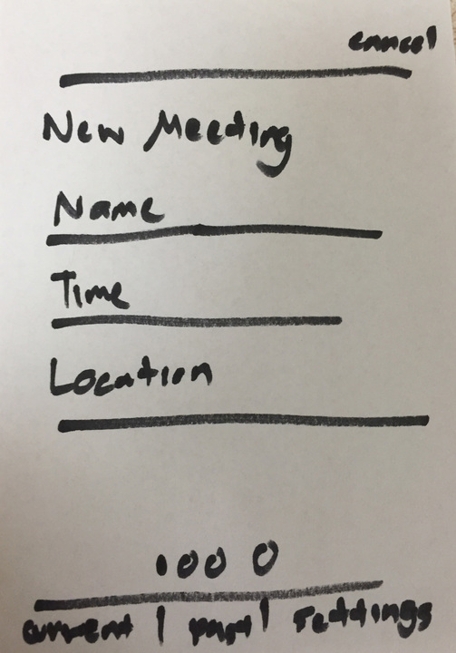
Notes:
Set Name, title, and location

Slide 11
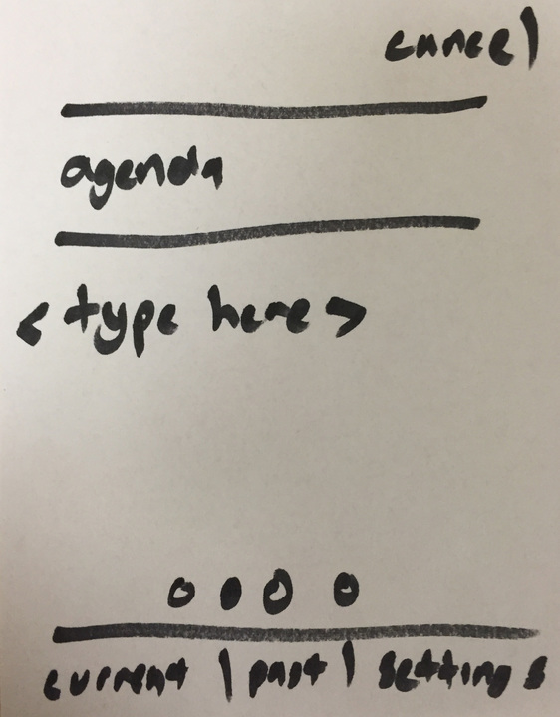
Notes:
Set agenda

Slide 12
TASK 2: INVITE THE NECESSARY PEOPLE

Slide 13
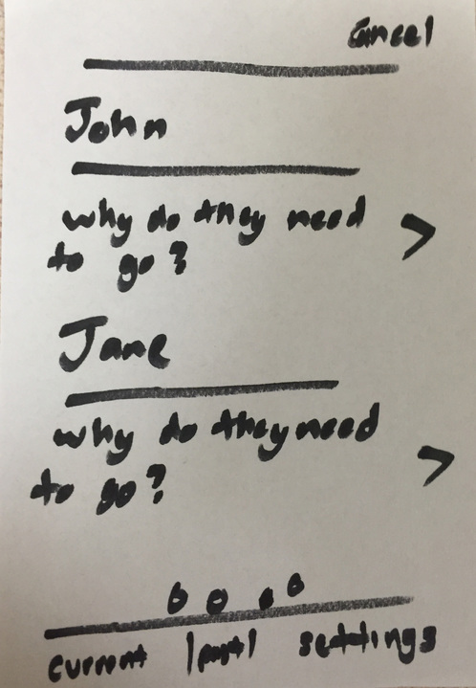
Notes:
Invite list

Slide 14
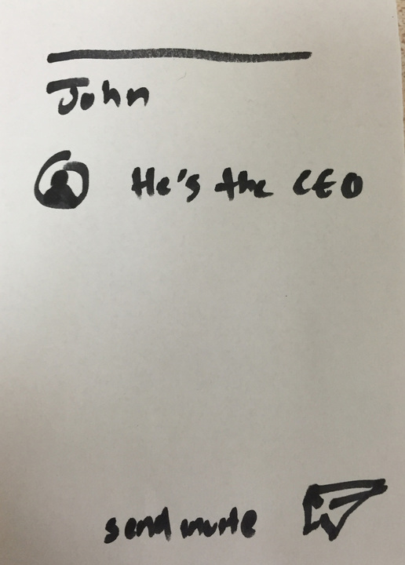
Notes:
Why does he need to be there

Slide 15
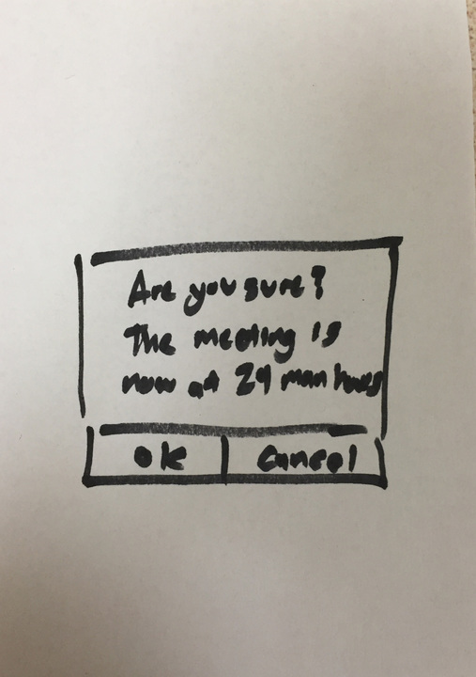
Notes:
pop-up alert

Slide 16
TASK 3: ATTENDEE RSVP

Slide 17
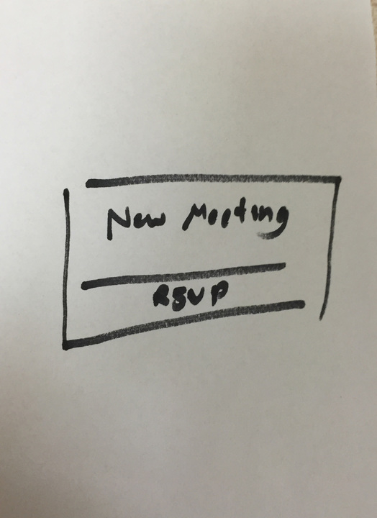
Notes:
Push notification for attendee

Slide 18
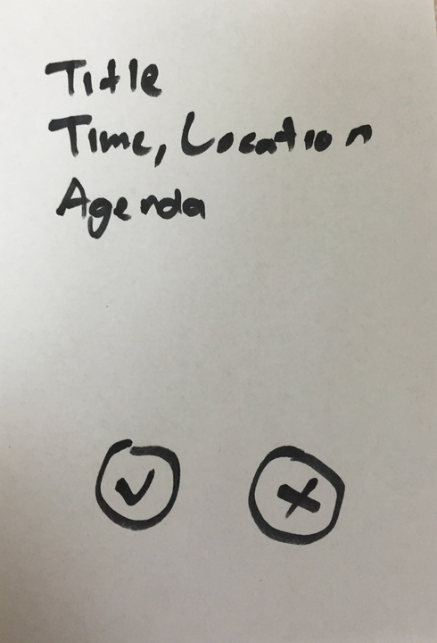
Notes:
Read agenda and rsvp

Slide 19
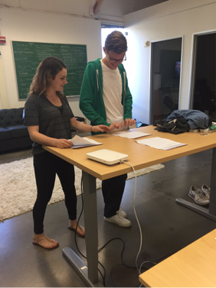
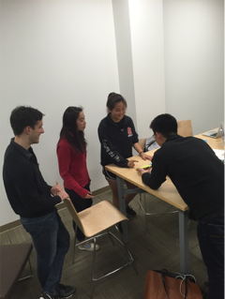
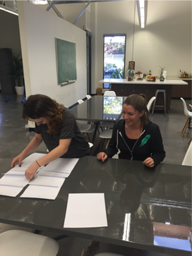
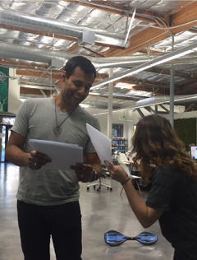
METHOD
Notes:
Range of different “tech prowess abilities.” Different interests, races, genders. Fulltime employees and students.
Jack is 21 years old and grew up in the Bay Area. He is currently a student at Santa Clara studying sociology with a concentration in group communication. We selected Jack because he self identifies as an “early adopter of new technology,” and enjoys interacting with early stage prototypes. Additionally, we felt he would provide an interesting prospective given our product’s relationship to his field of study.
SOCIOLOGY STUDENT FOCUS ON GROUP COMMUNICATION: NON-POWER-USER

Slide 20
METHOD
Notes:
Stacy is from New York and is a senior at Stanford studying economics. We ran this experiment in a study room at Stanford with minimal distractions.
STANFORD STUDENT

Slide 21
METHOD
Notes:
Sonia is 25 years old and graduated from Cornell with a degree in creative writing. She began working at Robinhood this week in user-experience research and design. Sonia was selected because she is a full-time employee and has no previous knowledge of our project.
EMPLOYEE

Slide 22
METHOD
Notes:
Shrey is 31 years old and was selected because he is an extreme user. Attending around 5 meetings a day, most of which he organizes. We performed this experiment while walking to see how the experience held up on the go. While juggling the papers was tough, the experiment worked well while walking.
POWER-USER

Slide 23
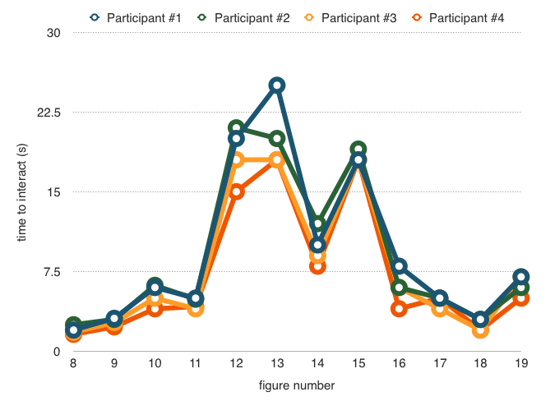
RESULTS – TIME TO INTERACT
Notes:
Were the results given in sufficient detail to understand what occurred?
Labeled screens.
Power user highest, consistent across. Biggest pain points are transition screens.

Slide 24
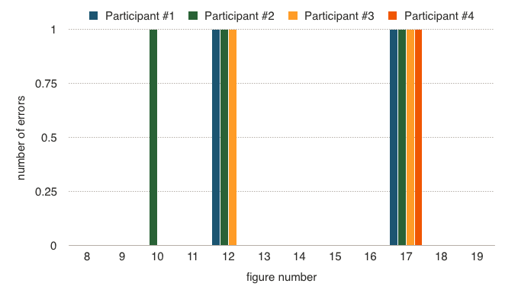
RESULTS – ERRORS
Notes:
Number of errors. Again, biggest pain points when first come to transition. Partly due to paper interface

Slide 25
SUGGESTED UI CHANGES
Notes:
Were the suggested UI improvement sound and follow from the results?
Biggest errors around navigation change. Let users know how they can move between screens. TTI low, but this would help that too.
Participant says doesn’t always have agendas for meetings. Allow chats where some screens like agendas are optional.
Lots of reconsidering after man hours. Maybe make it even more visual.
Not many people want to go to past meetings. Switch to two tab layout with more.
Ability to un-invite people or change the agenda. Edit screen.

Slide 26
SUMMARY
BetterMeet:
Purposeful Meetings
Notes:
Overall, we gained many insights on the app and felt that our app did seem to achieve the goal of reducing meetings and meeting attendees. Participants were generally receptive to the idea and could see the need for a tool like BetterMeet. We hope to incorporate the feedback and insights we’ve gained from this week to redesign and improve user flow and experience in our next prototype.

Slide 27
QUESTIONS?

